Slide 1
CoronaSurveys: Using Surveys with Indirect Reporting to Estimate the Incidence and Evolution of Epidemics
Oluwasegun Ojo, Augusto García-Agundez, Benjamin Girault, Harold Hernández, Elisa Cabana, Amanda García-García, Payman Arabshahi, Carlos Baquero, Paolo Casari, Ednaldo José Ferreira, Davide Frey, Chryssis Georgiou, Mathieu Goessens, Anna Ishchenko, Ernesto Jiménez, Oleksiy Kebkal, Rosa Lillo, Raquel Menezes, Nicolas Nicolaou, Antonio Ortega, Paul Patras, Julian C Roberts, Efstathios Stavrakis, Yuichi Tanaka, Antonio Fernández Anta
and https://coronasurveys.org/team/

Slide 2
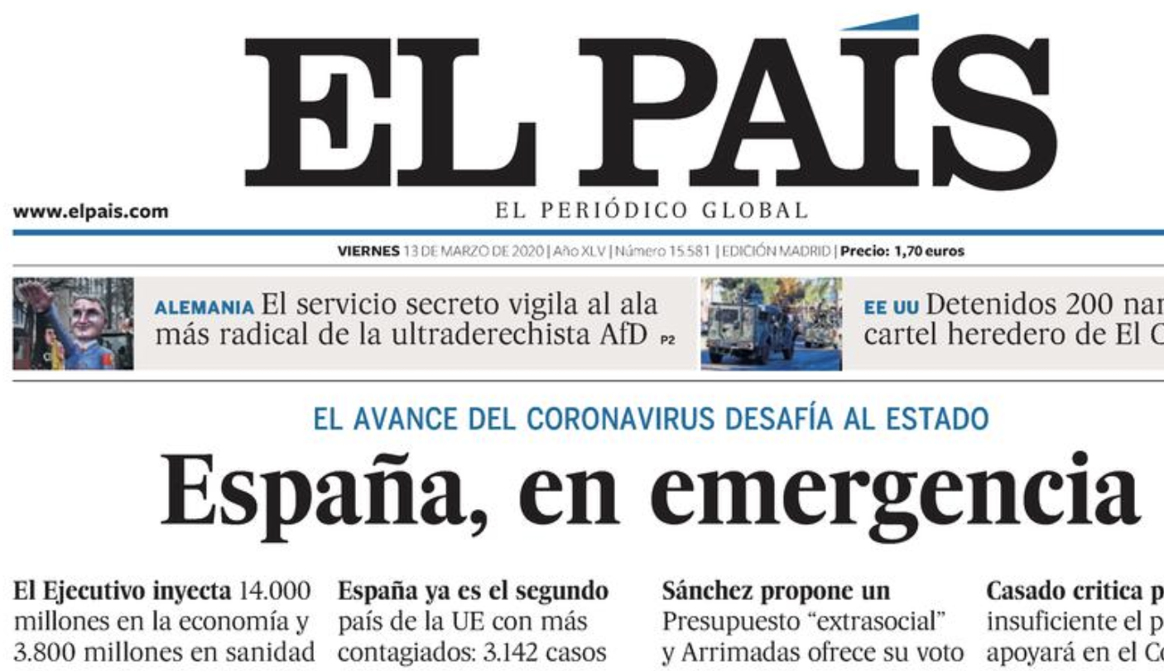
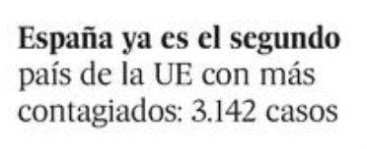
COVID-19, March 13th, 2020
3,142 confirmed cases.
How many actual cases?

Slide 3
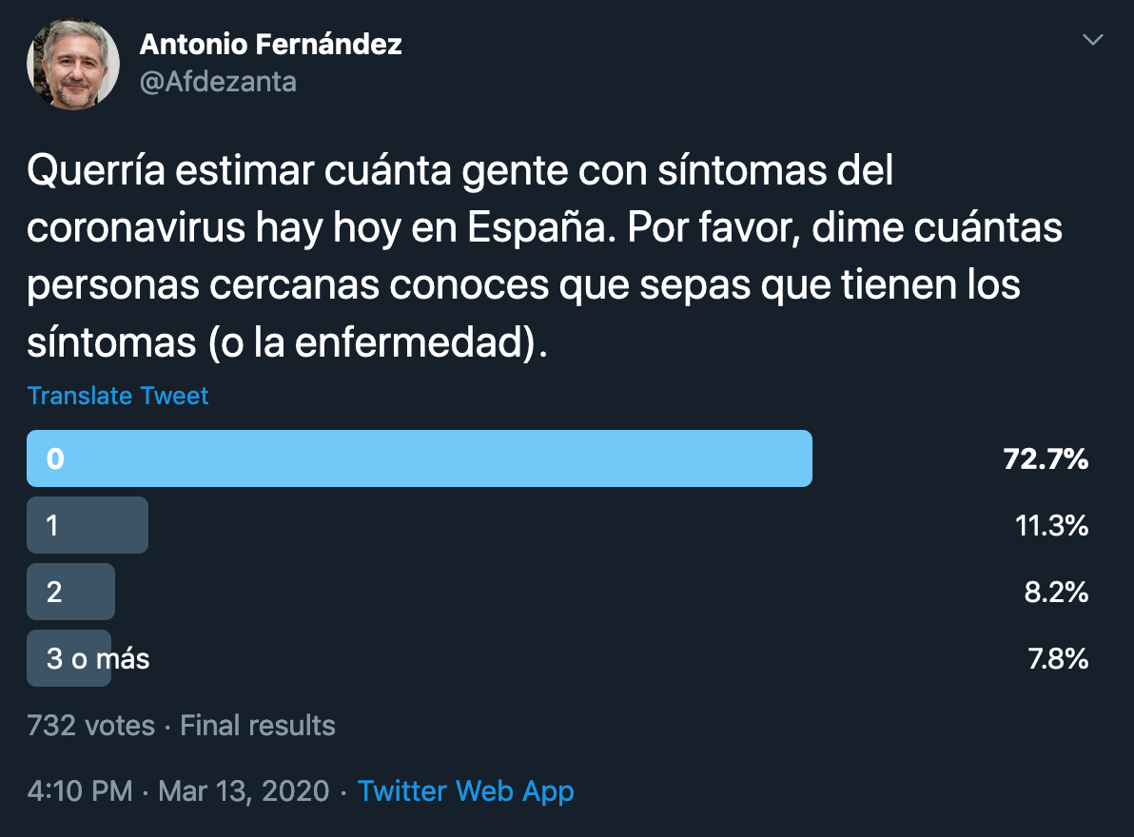
Twitter Survey
Assuming each participant knows 150 people (Dunbar number) the estimate is roughly 150,000 infected by March 14th

Slide 4

CoronaSurveys Project
Survey with indirect reporting to monitor the evolution of the pandemic
Available in more than 60 languages for all countries (at regional level in 150)

Slide 5

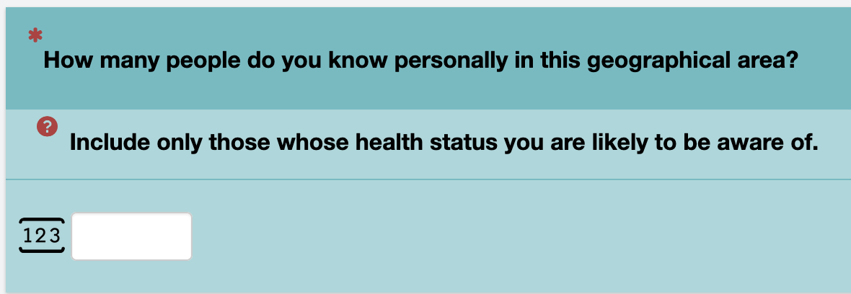
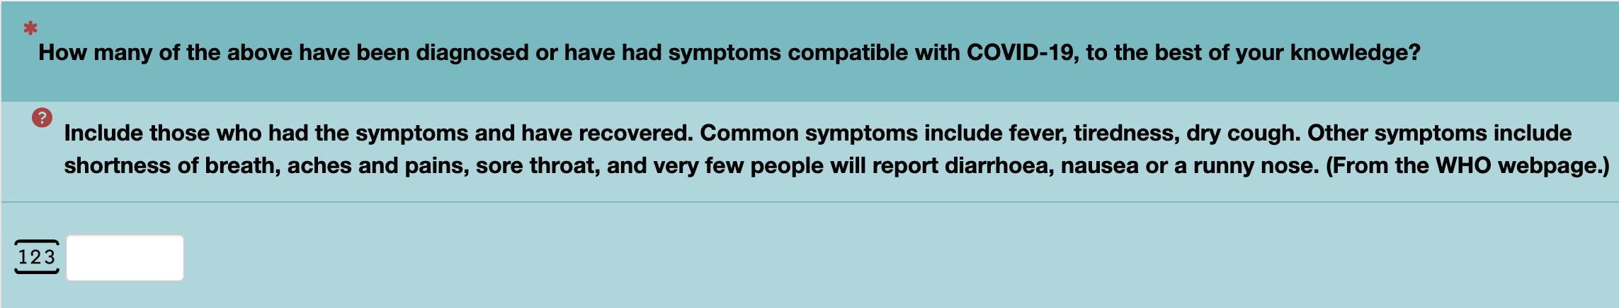
Indirect Reporting
REACH
CASES

Slide 6
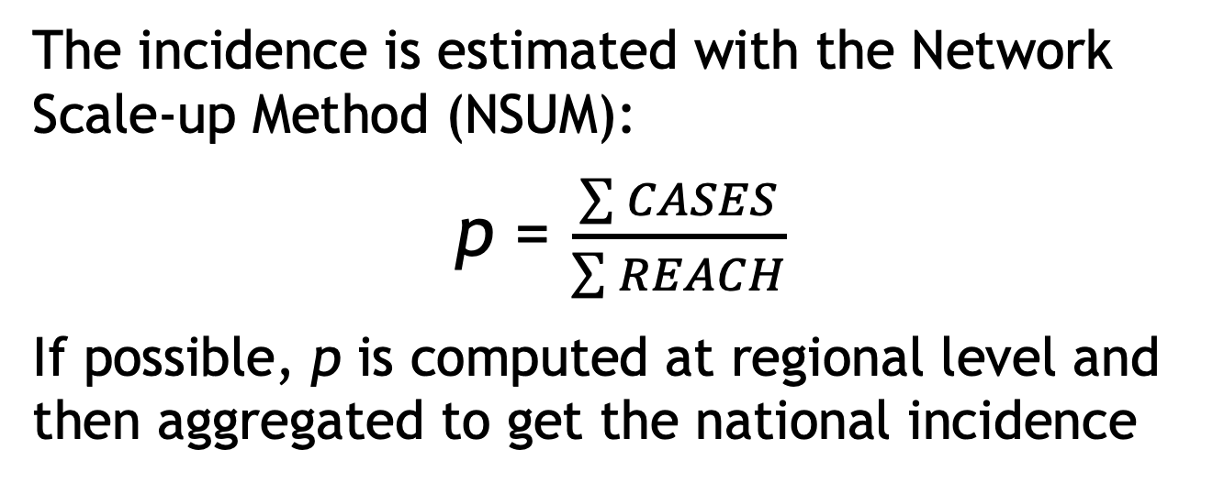
Estimating the Incidence of COVID
The incidence is estimated with the Network Scale-up Method (NSUM):
p = $\frac{\sum{CASES}}{\sum{REACH}}$
If possible, p is computed at regional level and then aggregated to get the national incidence
H Russell Bernard, Eugene C Johnsen, Peter D Killworth, and Scott Robinson. Estimating the size of an average personal network and of an event subpopulation: Some empirical results. Social science research 20, 2 (1991), 109–121.

Slide 7

Social Network
Ratio of people with glasses or a beard? Ground truth: 24/102 = 23.5%
Source: https://www.euroscientist.com/imagine-a-social-network-like-facebook-with-no-facebook/

Slide 8
Direct vs Indirect Reporting
Direct reporting
Indirect reporting

Slide 9
Direct vs Indirect Reporting
Indirect reporting
Reach: 7
Estimate: 2/7=28.6%
Direct reporting Reach: 1
Estimate: 0/1=0%
Persons sampled (responses): 1
Ratio of people with glasses or a beard?
Ground truth: 24/102 = 23.5%

Slide 10
Direct vs Indirect Reporting
Indirect reporting
Reach: 14
Estimate: (2+1)/(7+7)=21.4%
Direct reporting Reach: 2
Estimate: 1/2=50%
Persons sampled (responses): 2
Ratio of people with glasses or a beard?
Ground truth: 24/102 = 23.5%

Slide 11
Direct vs Indirect Reporting
Indirect reporting
Reach: 18
Estimate: (2+1+2)/(7+7+6)=25%
Direct reporting Reach: 3
Estimate: 2/3=66.7%
Persons sampled (responses): 3
Ratio of people with glasses or a beard?
Ground truth: 24/102 = 23.5%

Slide 12
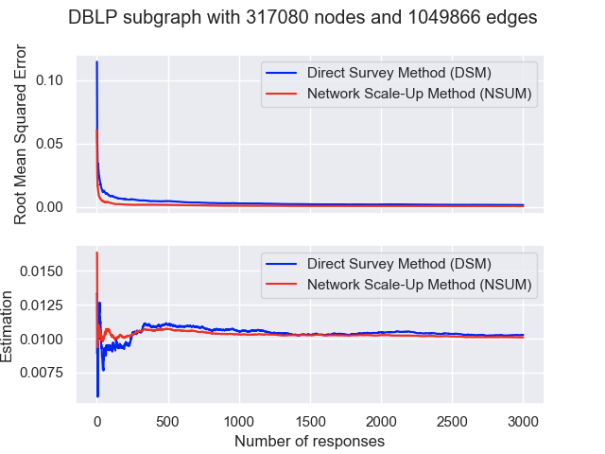
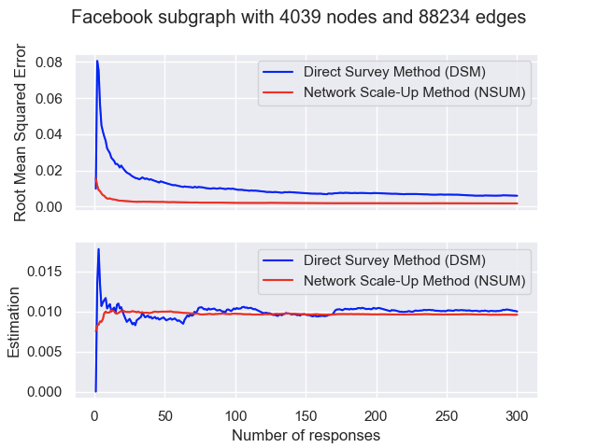
Simulating (In)Direct Reporting
Simulating sampling processes with direct and indirect reporting (NSUM):
Uniform distribution of infected
Uniform sampling
NSUM converges much faster to the correct value p=0.01

Slide 13
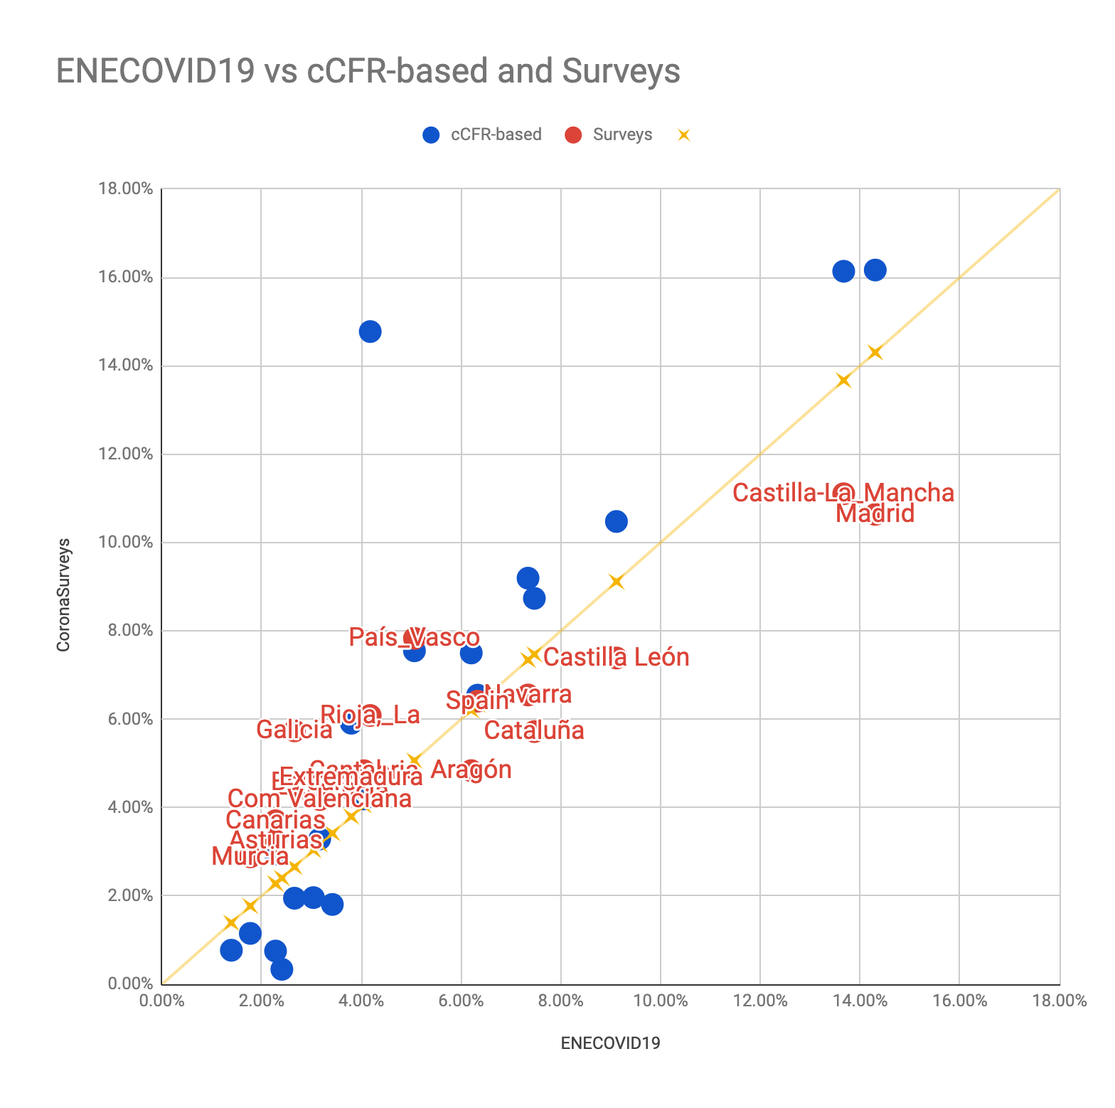
Validation: Serology Study & cCFR
Pollán, Marina, et al. "Prevalence of SARS-CoV-2 in Spain (ENE-COVID): a nationwide, population-based seroepidemiological study." The Lancet (2020)
T Russel et al. Using a delay-adjusted case fatality ratio to estimate under-reporting. Centre for Mathematical Modelling of Infectious Diseases Repository (2020)

Slide 14
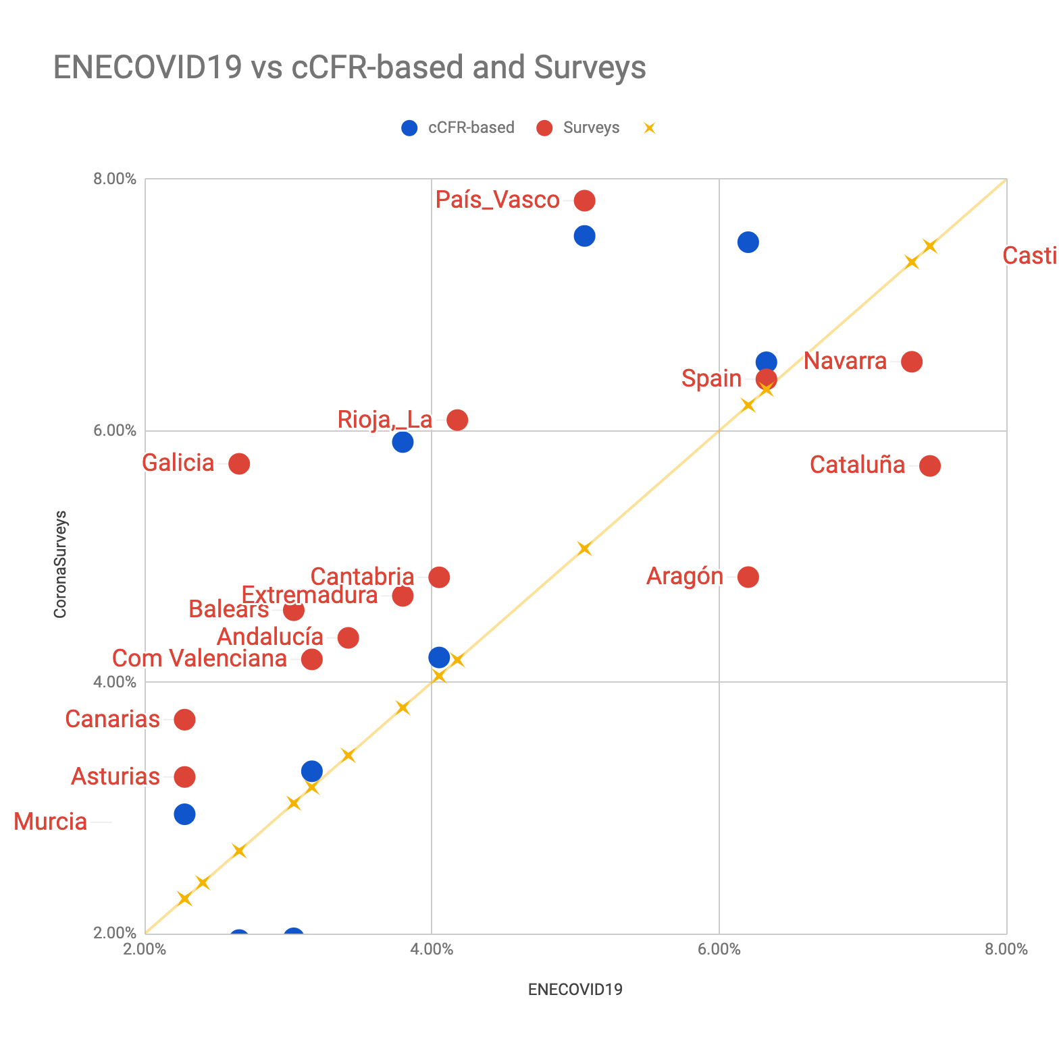
Validation: Serology Study & cCFR
Pollán, Marina, et al. "Prevalence of SARS-CoV-2 in Spain (ENE-COVID): a nationwide, population-based seroepidemiological study." The Lancet (2020)
60,000 people tested (in each wave)
Medical teams all over the country
2 weeks of collecting samples
$$$
~3000 responses

Slide 15
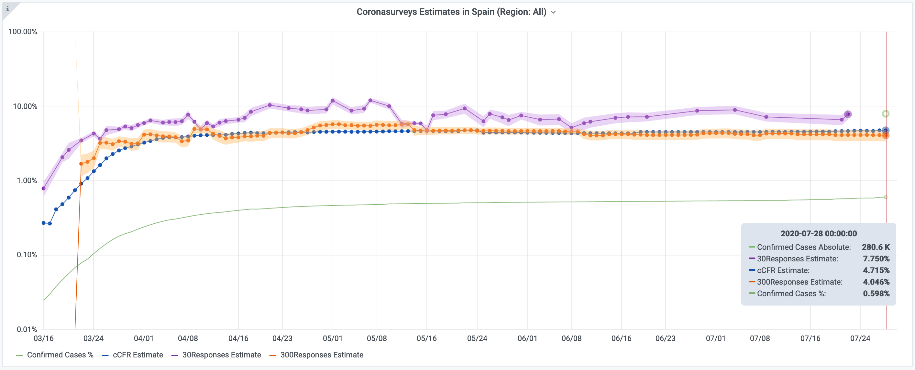
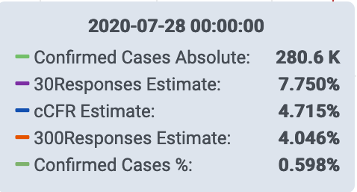
Incidence Evolution: Spain
cCFR-based estimates are good in countries with good data

Slide 16
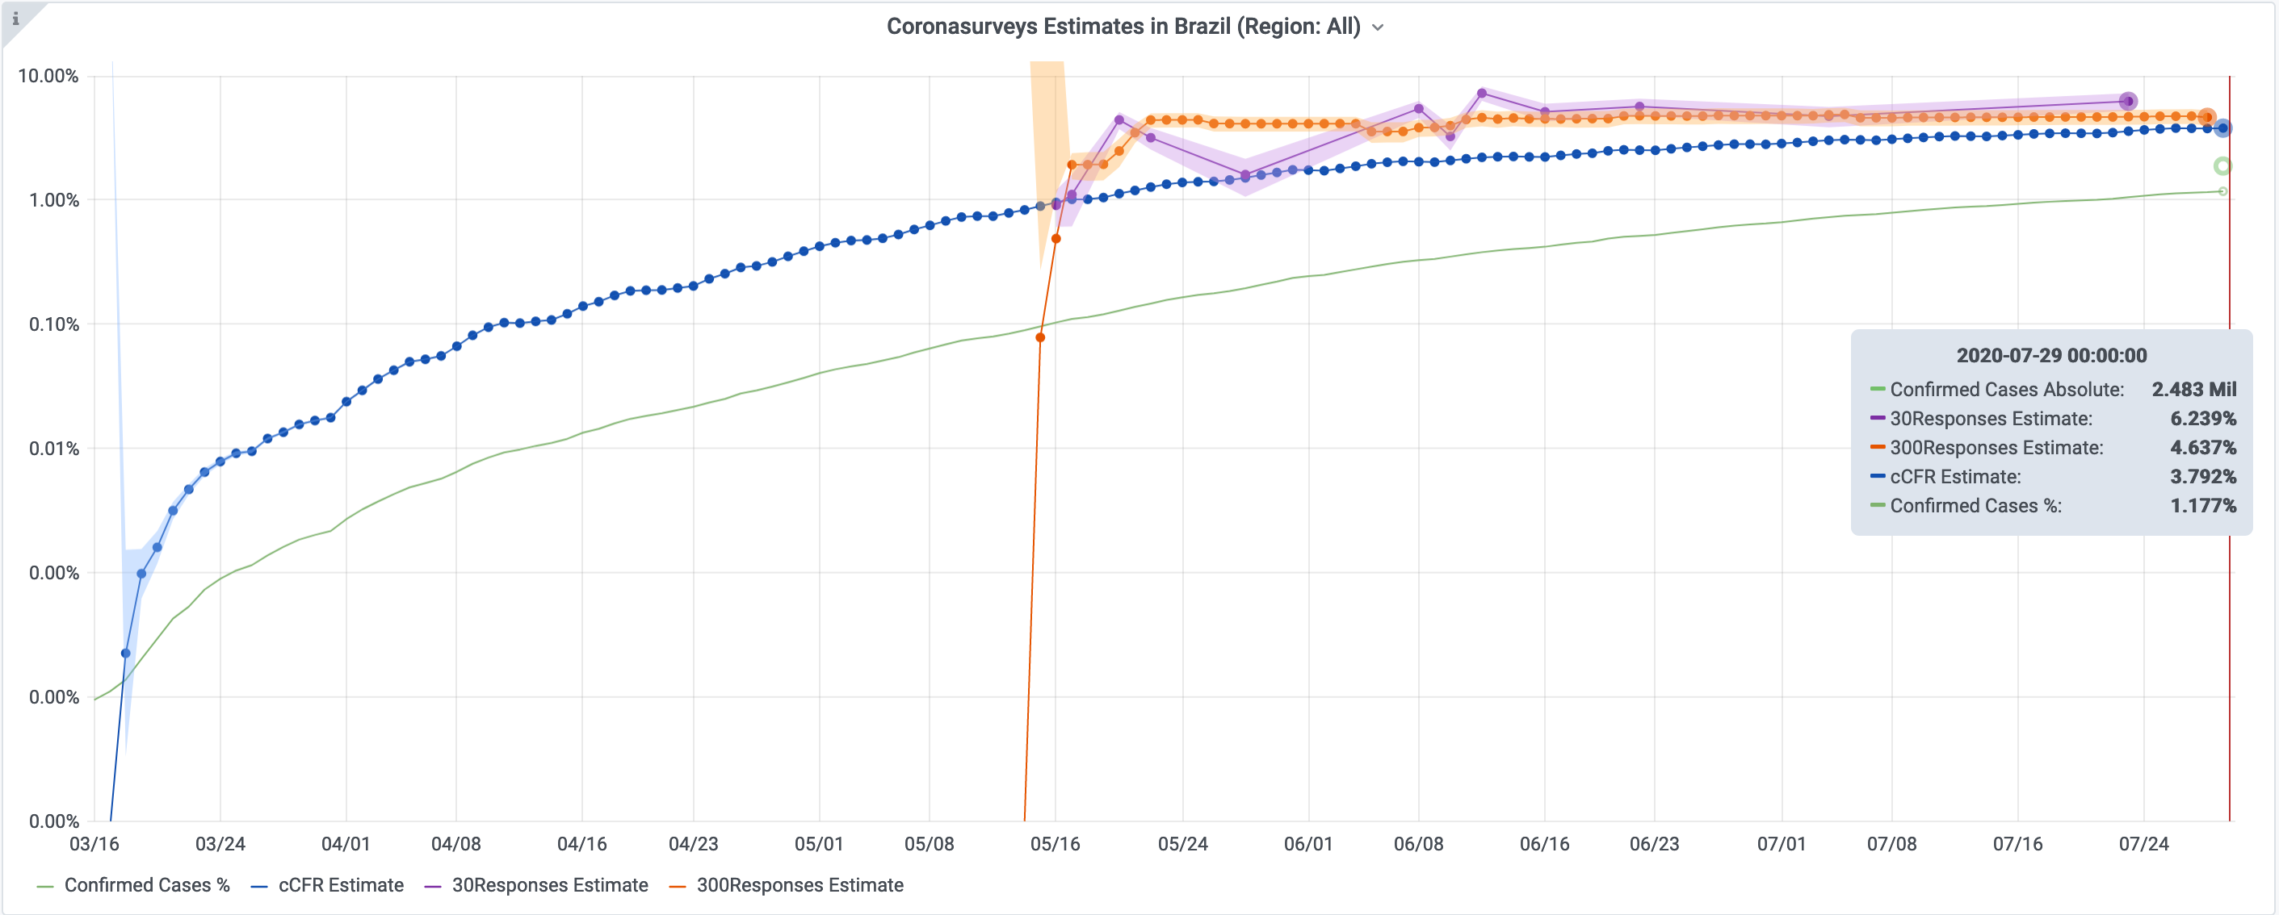
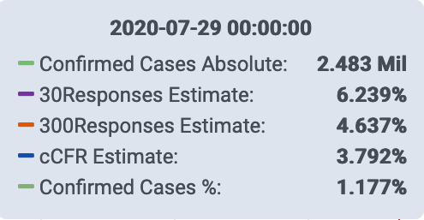
Incidence Evolution in LMIC: Brazil
Low cCFR-based estimate may be due to the data

Slide 17
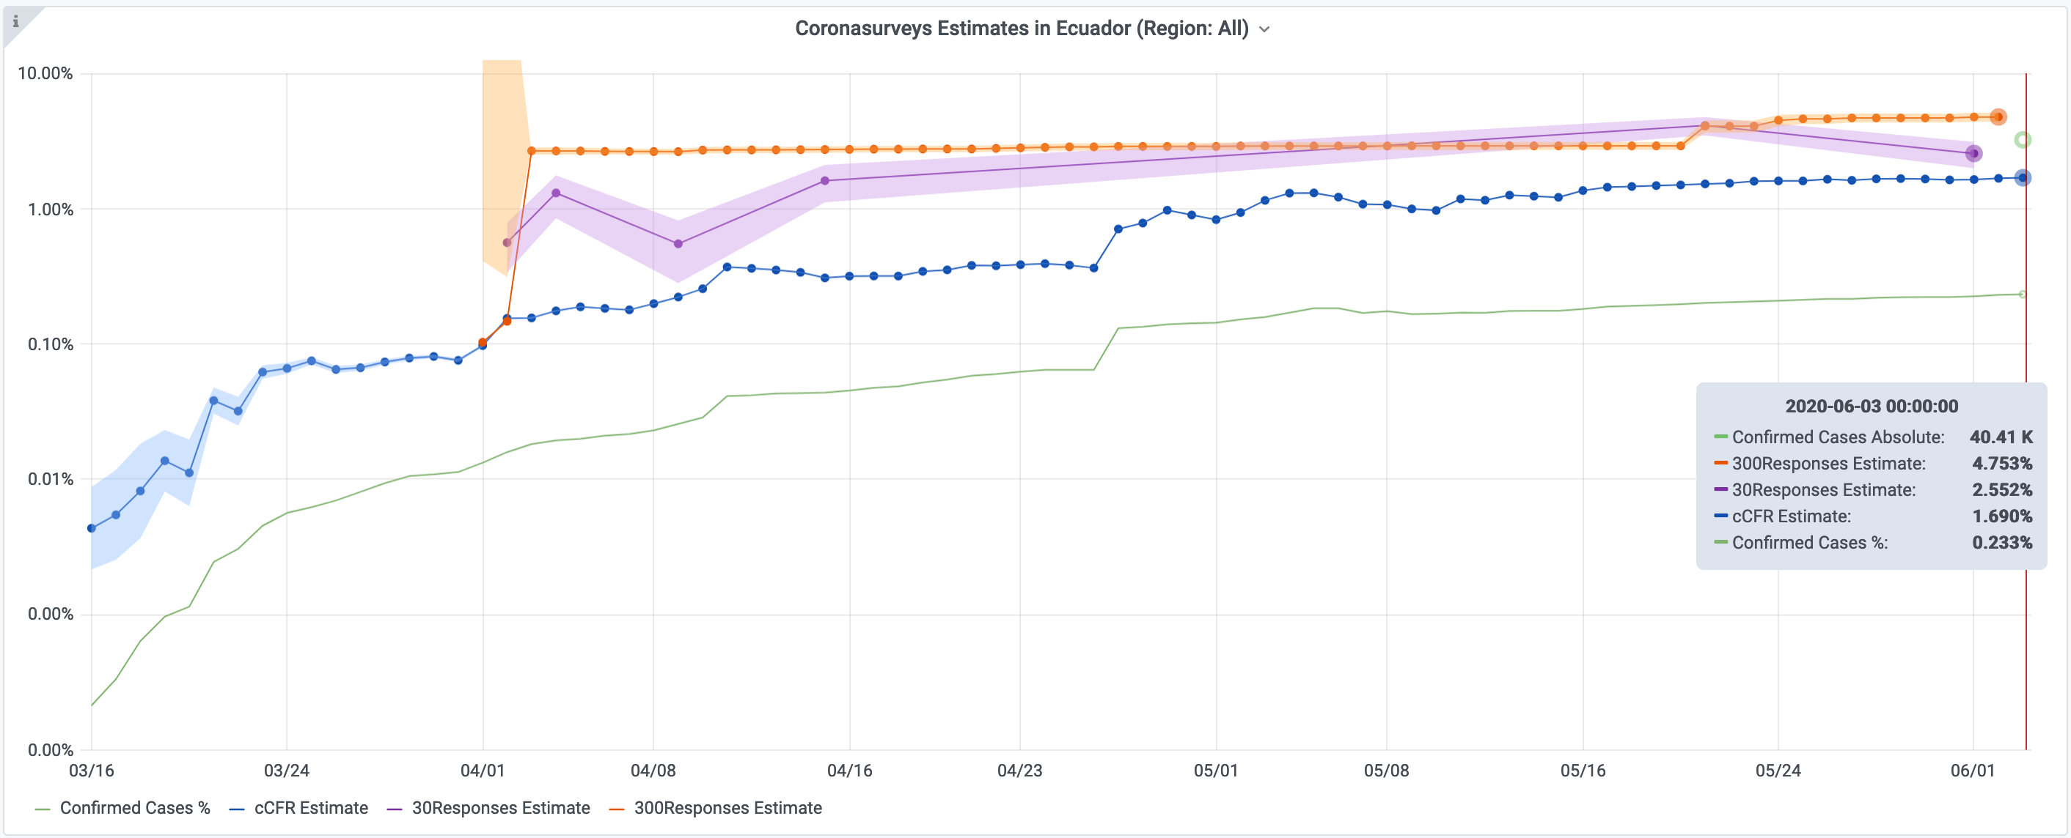
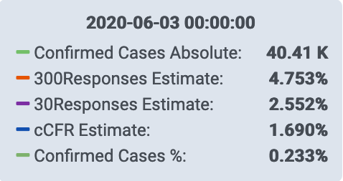
Incidence Evolution in Ecuador

Slide 18
Conclusions
Indirect reporting and Network Scale-up Method
Useful tool to track pandemic evolution
Easy, fast, and cheap to deploy
Possible game changer for LMIC
Complements and contrasts the data available
Good estimates even with limited number of responses
Main challenge: maintain constant flow of responses
Next step: detect (and hopefully forecast) bursts

Slide 19
Thank you!
https://coronasurveys.org

Slide 20
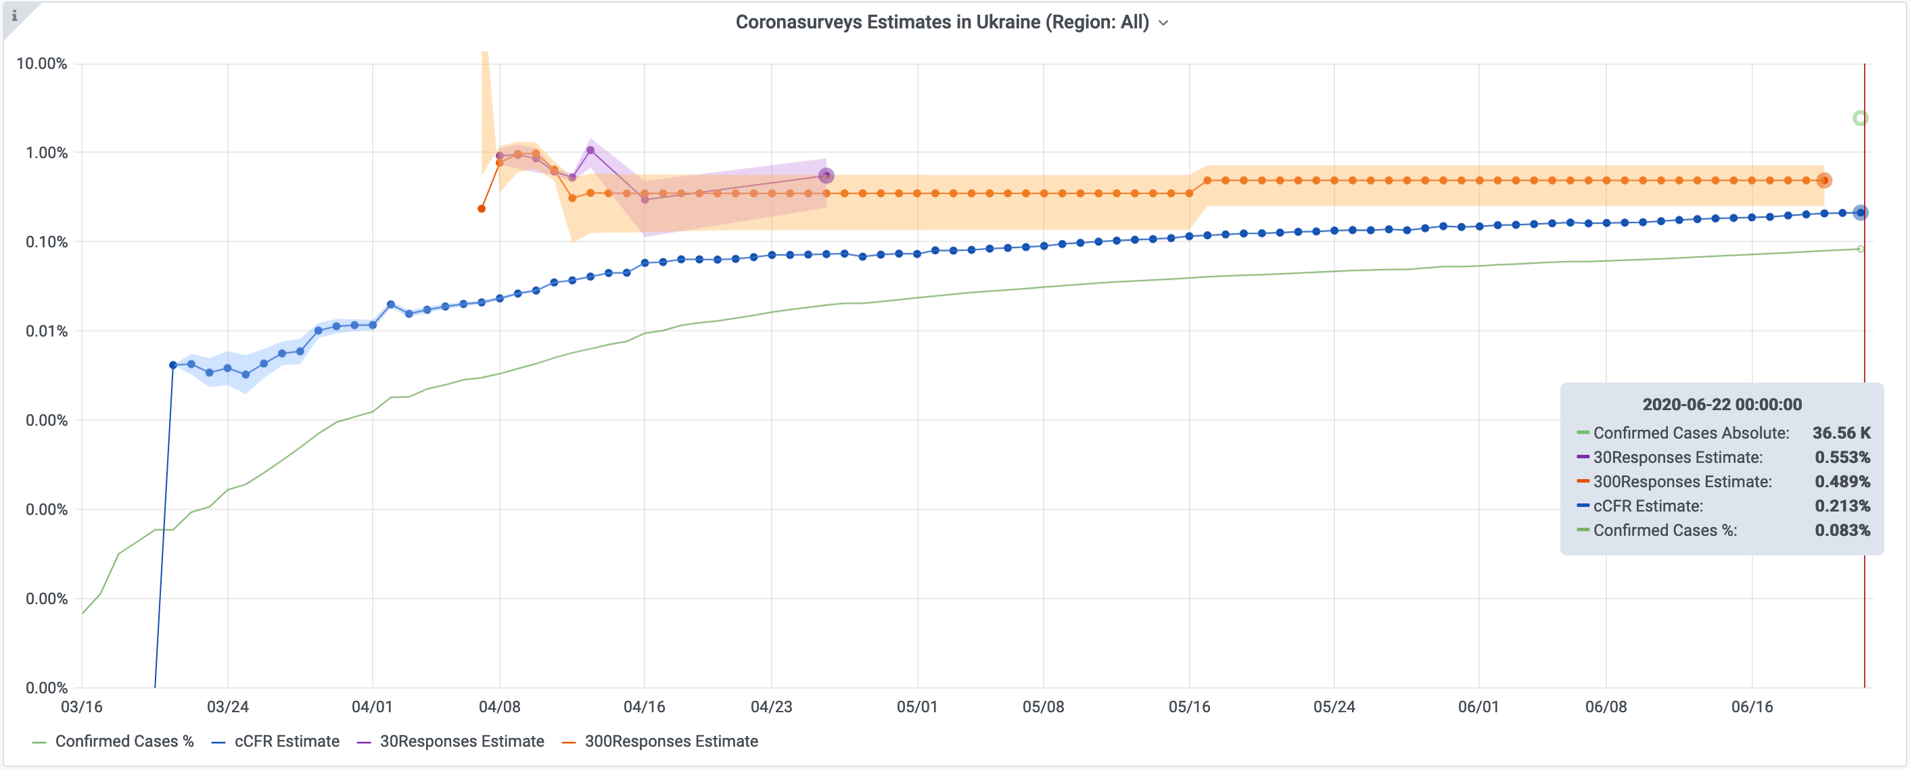
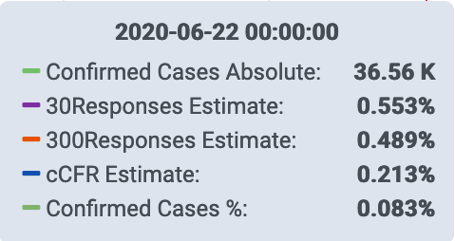
Incidence Evolution in Ukraine

